Slide 1

Week 7:
Recurrent Neural Network
Machine Learning Using Tensorflow
Shu-Ting Pi, PhD
UC Davis

Slide 2

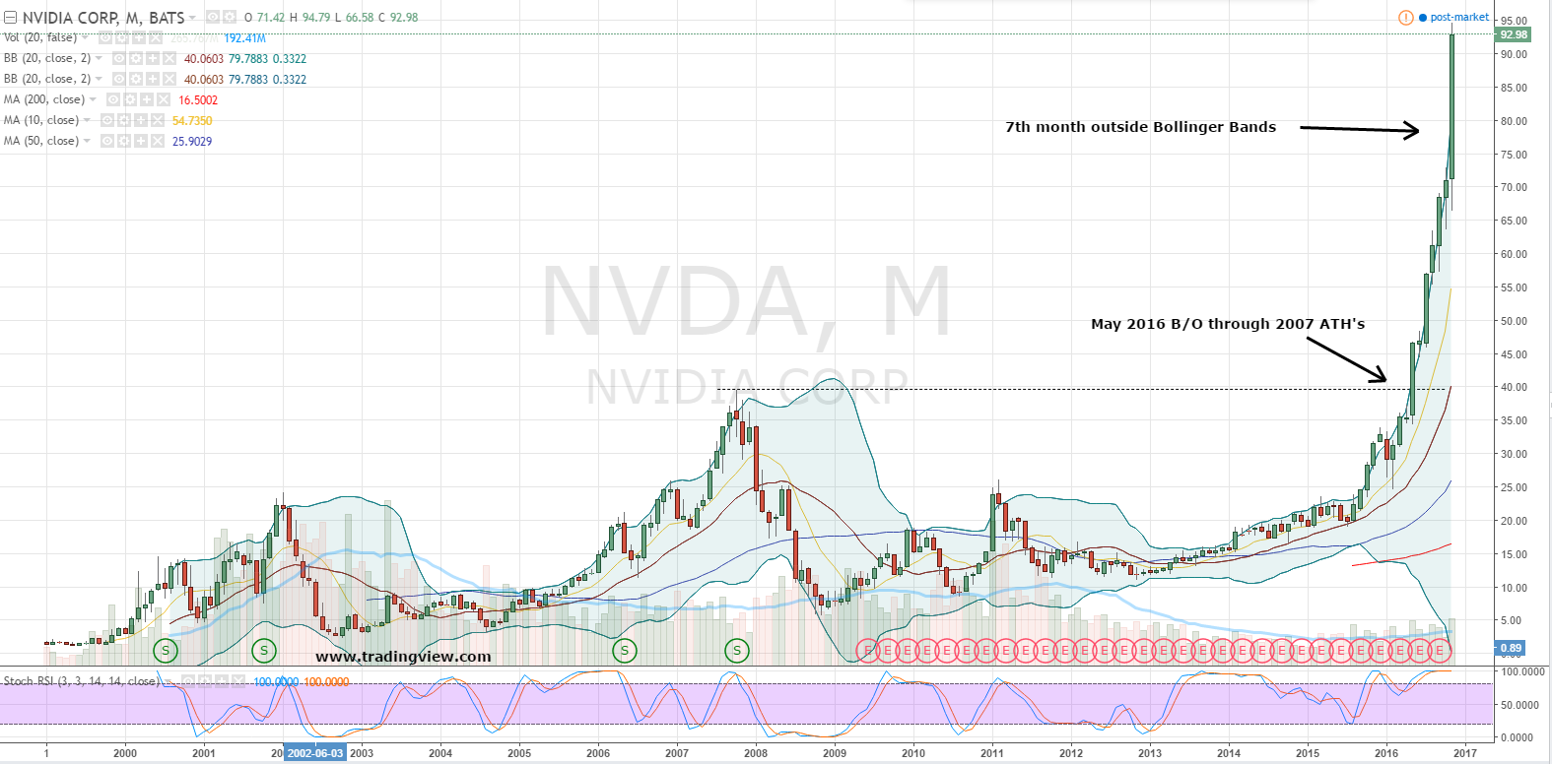
Time Series Problem
Data sequence are not considered in MLP or CNN !
Machine Learning using Tensorflow
Shu-Ting Pi

Slide 3
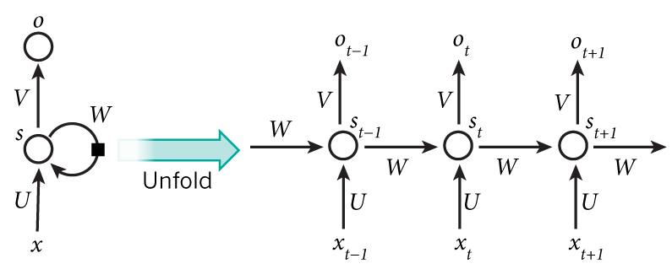
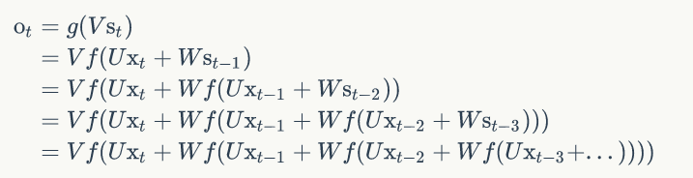

Recurrent Neural Network (RNN)
Machine Learning using Tensorflow
Shu-Ting Pi

Slide 4
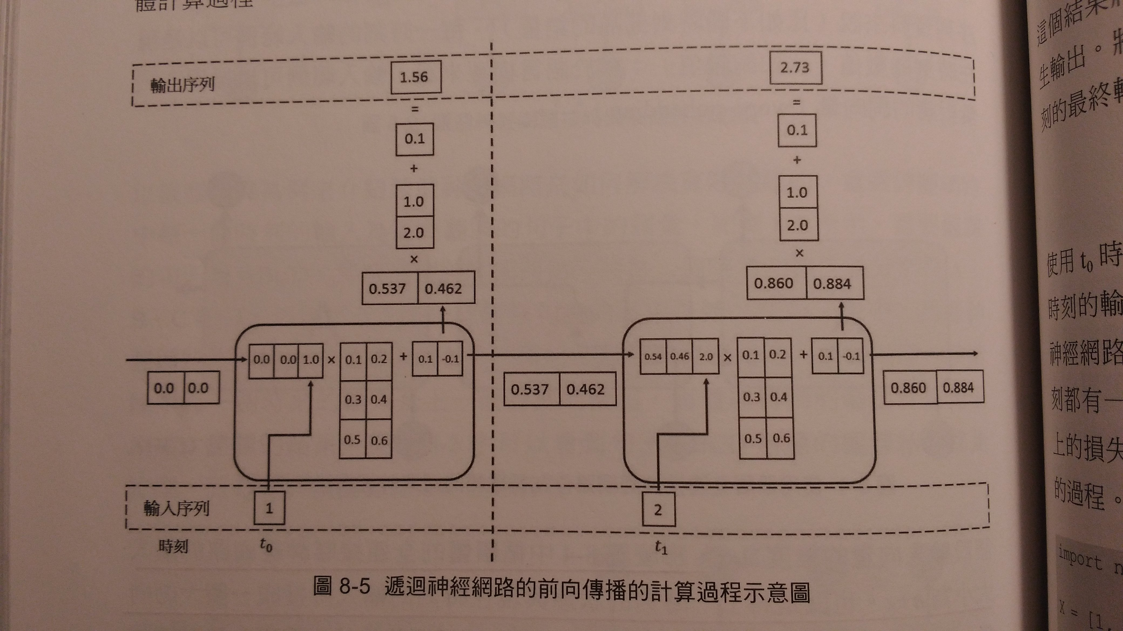
Details of Cell
Size of the “state” (or size of hidden unit, or size of the cell) is something you need to specify !
Machine Learning using Tensorflow
Shu-Ting Pi

Slide 5
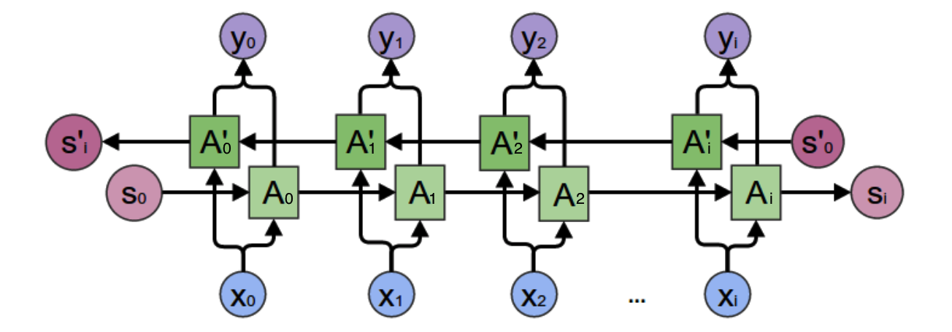
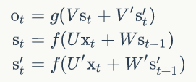


Bidirectional RNN
Machine Learning using Tensorflow
Shu-Ting Pi

Slide 6
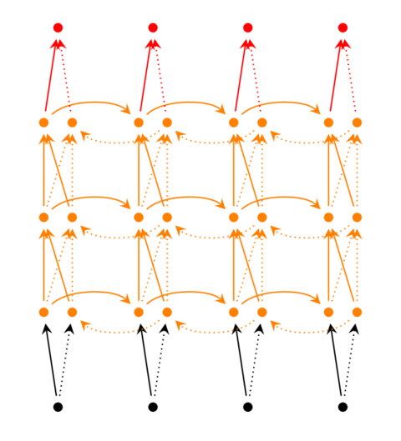
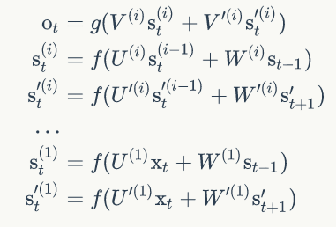
Deep RNN
Machine Learning using Tensorflow
Shu-Ting Pi

Slide 7
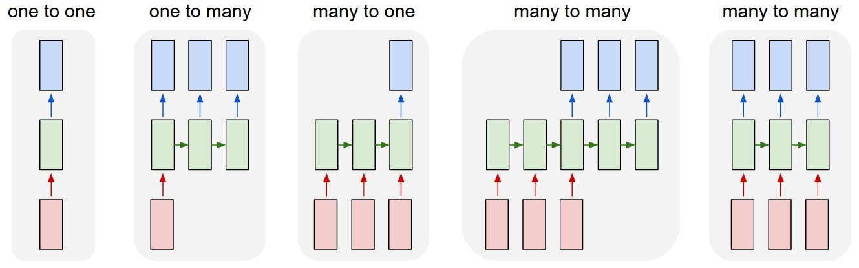
Correspondence of RNN
Machine Learning using Tensorflow
Shu-Ting Pi

Slide 8
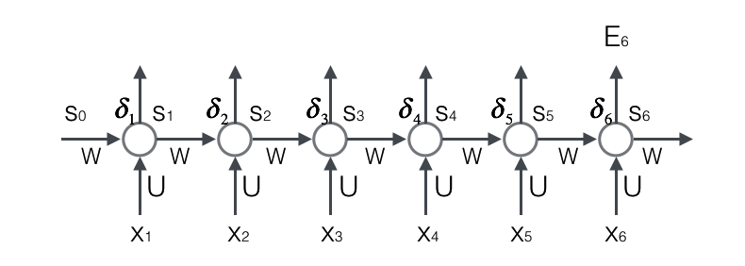
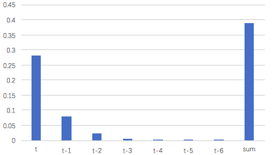
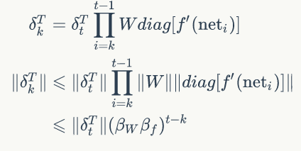
Gradient Problem
B < 1: Gradient vanishing
B > 1: Gradient explosion
Machine Learning using Tensorflow
Shu-Ting Pi

Slide 9
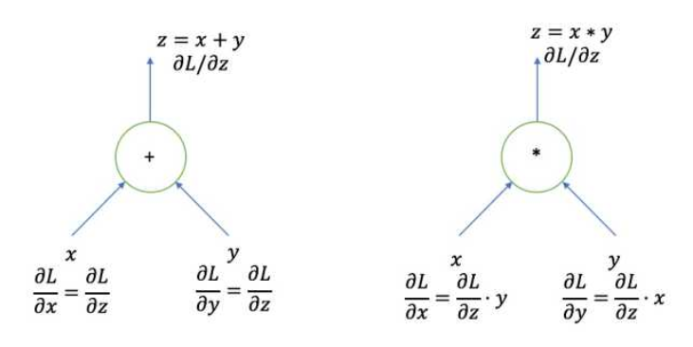
The gates
Forward: equal
Backward: equal
Forward: filter
Backward: scale
Machine Learning using Tensorflow
Shu-Ting Pi

Slide 10
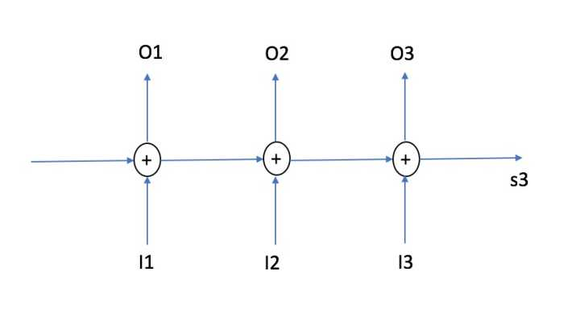
Add the network
O(1)
O(1)
O(1)
No gradient vanishing
Machine Learning using Tensorflow
Shu-Ting Pi

Slide 11
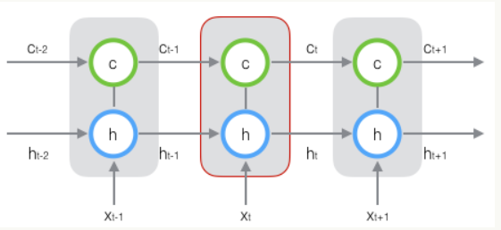
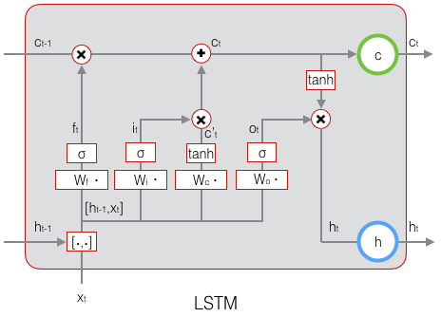
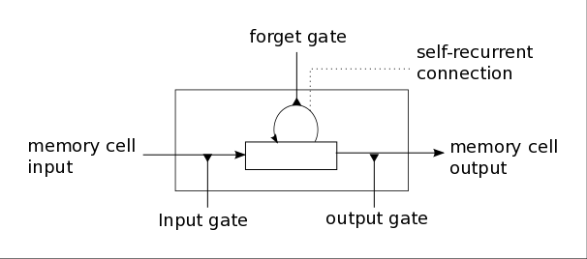
LSTM
f: forget gate, i:input state, o: output gate
c: state, h: output
Machine Learning using Tensorflow
Shu-Ting Pi

Slide 12
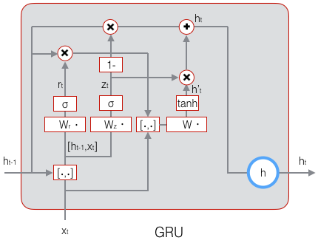
GRU
Z: update gate, r: reset gate, h: output state
Machine Learning using Tensorflow
Shu-Ting Pi

Slide 13
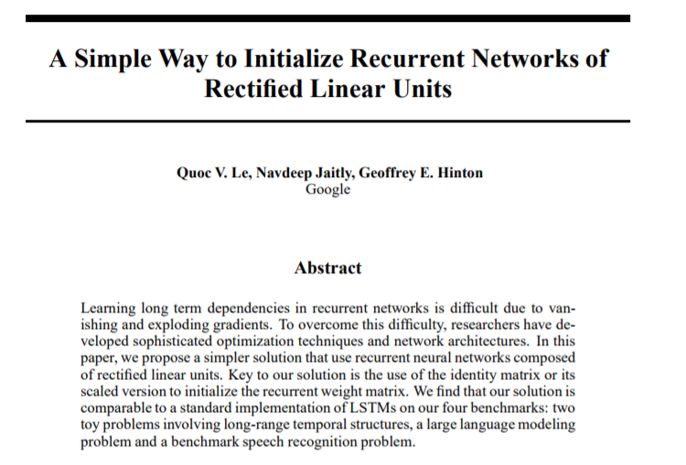
IRNN
Use: 1). Relu 2). identity matrix to initialize
Machine Learning using Tensorflow
Shu-Ting Pi

